Slide 1
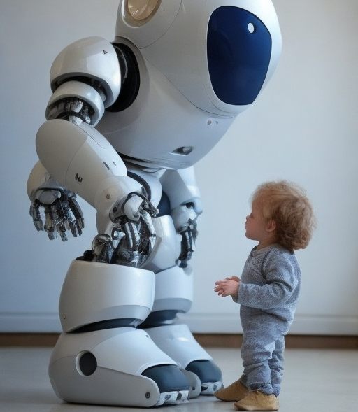
An Intelligent Robot For Monitoring And Protecting Toddlers
2023-326

Slide 2

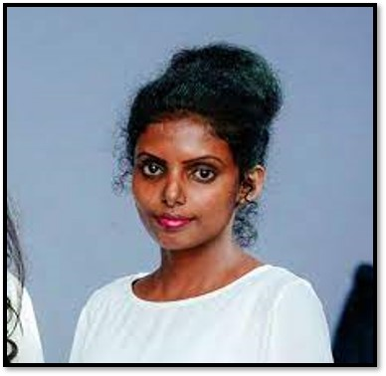




MEMBERS
Supervisor :
Prof.Sanath Jayawardhne
Co – Supervisor :
Rangi Liyanage
Ravindu Thuduhena
Shamal Weerarathne
Ravishka Lakshan
Danuka Maddepola

Slide 3
CONTENTS
INTRODUCTION
RESEARCH PROBLEMS
OBJECTIVES
SYSTEM DIAGRAM OVERVIEW
NEXT EXPECTED PROGRESS
OVERALL PROGRESS
OBJECTIVES & PROJECT COMPLETION
INDIVIDUAL PROGRESS
PROJECT EVIDENCE

Slide 4
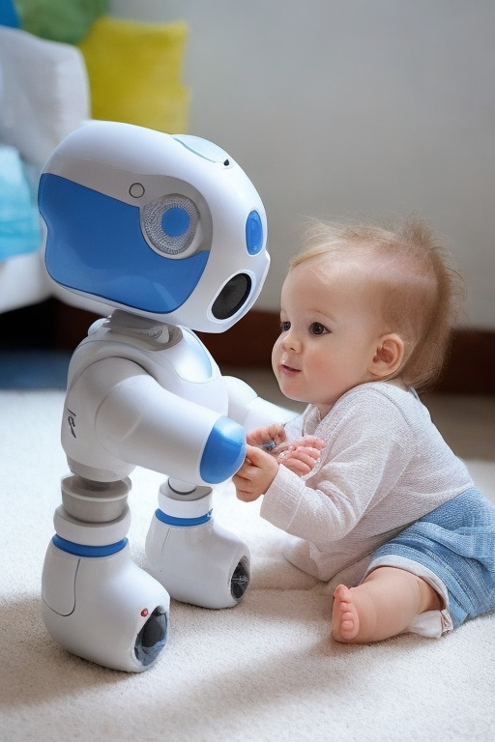
INTRODUCTION
Modern parents have busy schedules, domestic duties, and parenting responsibilities because of that, it is difficult for them to constantly keep an eye on toddlers.
Proposed project: build an intelligent robot that remotely watches children, detects unauthorized presence, and alert parents.
Main targeted beneficials are parents of toddlers age between 2 – 4. Additionally, this product can be developed targeting for childcare centres, playgrounds and nursery schools.
Technologies used to build the proposed project: Robotics, AI, ML, Image Processing, Open CV

Slide 5
FUNCTIONALITIES
Following the toddler and obstacle avoidance-based navigation.
Monitoring the toddler constantly while identify threats & environmental conditions.
Expelling animals that can be threatened to the toddler.
Automatically play lullabies when toddler crying.
Send alerts to the parents after capturing the child behaviors.

Slide 6

RESEARCH PROBLEMS
Lack of sufficient supervision
Limitation for Communication
Toddlers
Safety
Lack of flexibility to monitor while following toddler

Slide 7

RESEARCH OBJECTIVES
Main Objective
To develop a robot capable of caring for toddlers in the absence of their parents. Overall, the research aims to create a technology that can enhance child safety and provide peace of mind for parents and caregivers.

Slide 8

SUB OBJECTIVES
Developing a navigation system for the robot that can effectively and safely navigate around the toddler, incorporating the obstacle avoidance navigation and safe movement.
To establish a virtual monitoring system for the toddler's surroundings to provide parental oversight, detect any unauthorized presence and safeguard the toddler from identifying potential threats to the child's safety.
Create a system to identify toddler behaviors and notify parents when necessary.
Create music and lullabies playing system to calm down the toddler and help him to relax.
Create graphical user interface as a mobile application for parents to easily controlling and visualize the things.

Slide 9
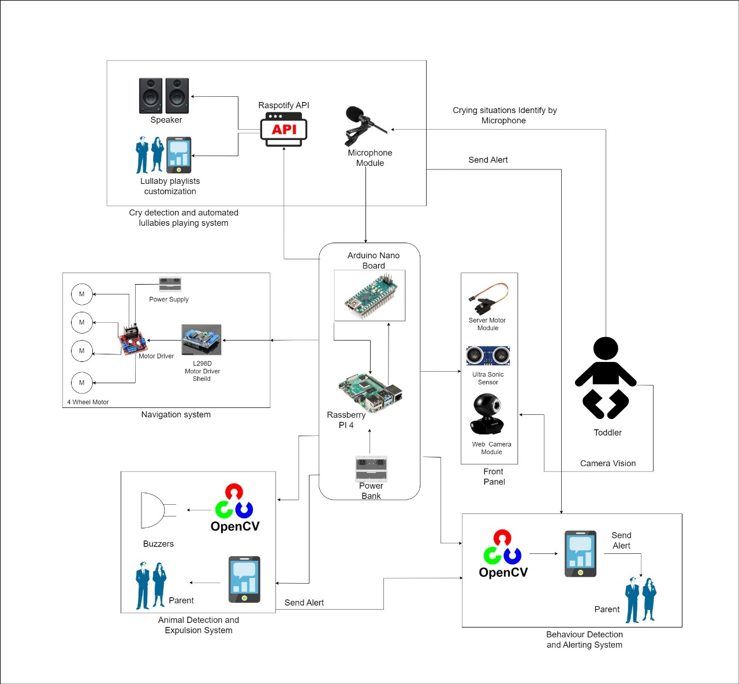
Overall System Diagram

Slide 10






TECHNOLOGIES
Firebase
Python
Raspberry
Database- Firebase
Middle Ware – Python
Raspberry- Pi single board computer
Arduino
TensorFlow
GitLab
Arduino technology
Middle Ware - TensorFlow
Version Control-GitLab

Slide 11

IT20185466 | R.S Thuduhena
BSc (Hons) in Information Technology
Specializing in Computer Systems & Network Engineering

Slide 12
Component -1
- Toddler Following and Obstacle Avoidance Robust Navigation System -

Slide 13
Introduction
Why toddler protecting robot needs navigation system ?
How this robot help to parents and
childcare givers ?
How robot follow the toddler ?
how robot identify the obstacles ?

Slide 14


Research Problem
How can we design and develop a secure and robust robot navigation system that can navigate around a toddler, utilizing obstacle avoidance techniques and safe mobility, while still allowing for non-threatening human-robot interaction, even in scenarios where the child may engage with or damage the robot.

Slide 15


Specific Objective
To develop a navigation system for the robot that can effectively and safely navigate around the toddler, incorporating the obstacle avoidance navigation and safe movement.

Slide 16

Sub Objectives
To effectively and safely navigate around a toddler.
To accurately tracking and following the toddler.
Incorporating the obstacle avoidance navigation.
Robot must be able to clear the area intelligently, for instance if the child interacts with or destroys it.
To engage in non-threatening human-robot interaction with a toddler.

Slide 17

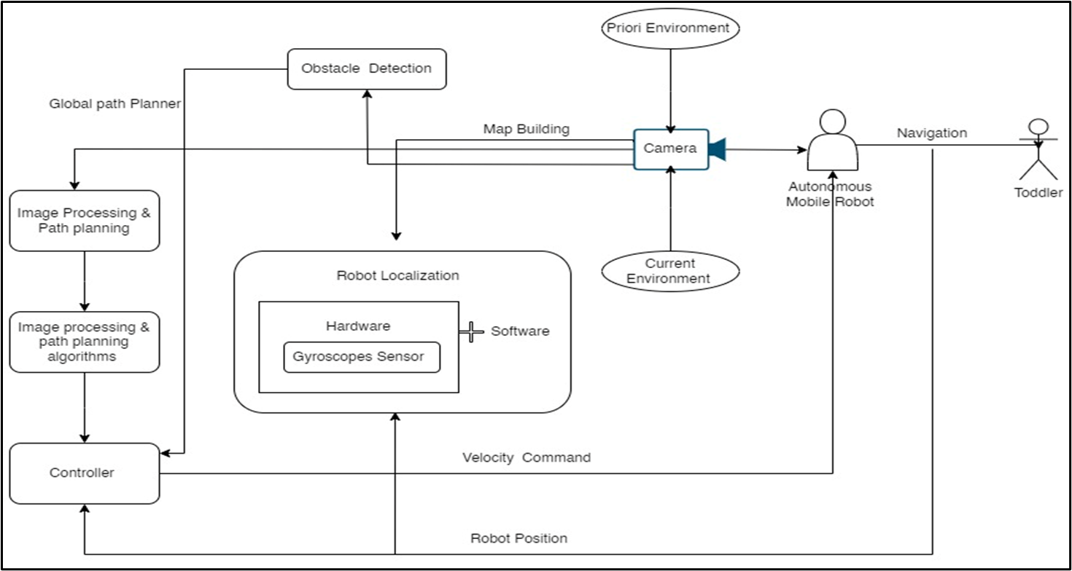
Methodology

Slide 18

Current Progress
Completed the Implementation of the pi-camera module and web camera module to track the toddler.
Implementation of the toddler tracking system is completed.
Configure the speed of the tracking object and positions of the object.
Develop The ML Model for Object avoidance navigation
Improving the model for safety navigation of robot

Slide 19

Results & Discussion
Results
Mobility Performance
Obstacle Detection and Avoidance Accuracy
Human Interaction and Safety
Discussion
Obstacle Détection and Avoidance Enhancement
Low FPS Issue
Safety Measures

Slide 20
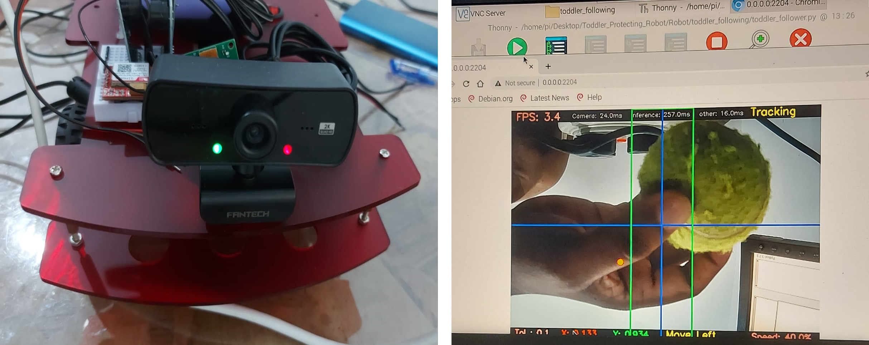
Project Evidence

Slide 21
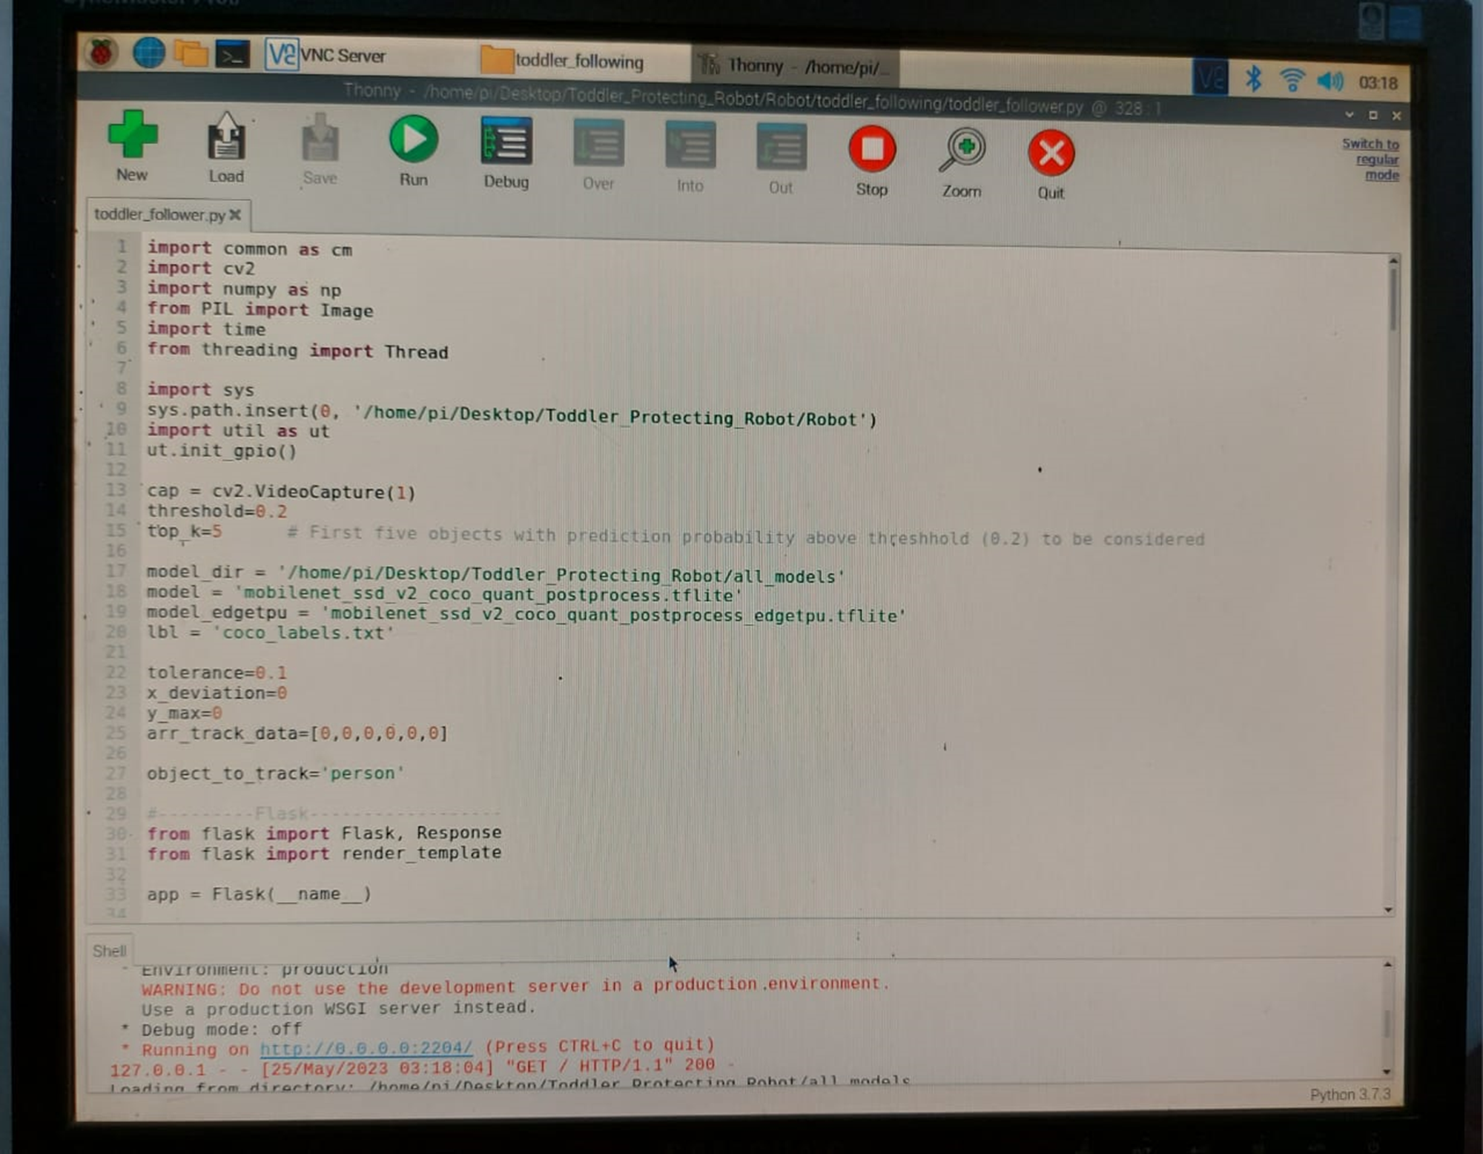
Project Evidence

Slide 22
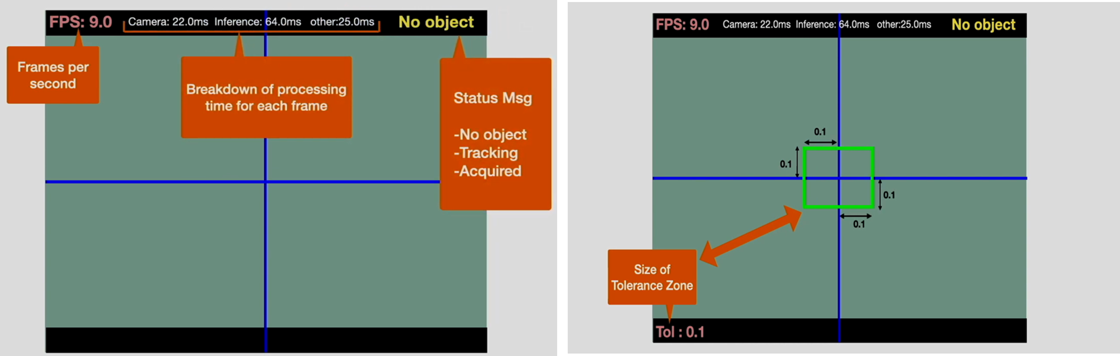
Project Evidence

Slide 23
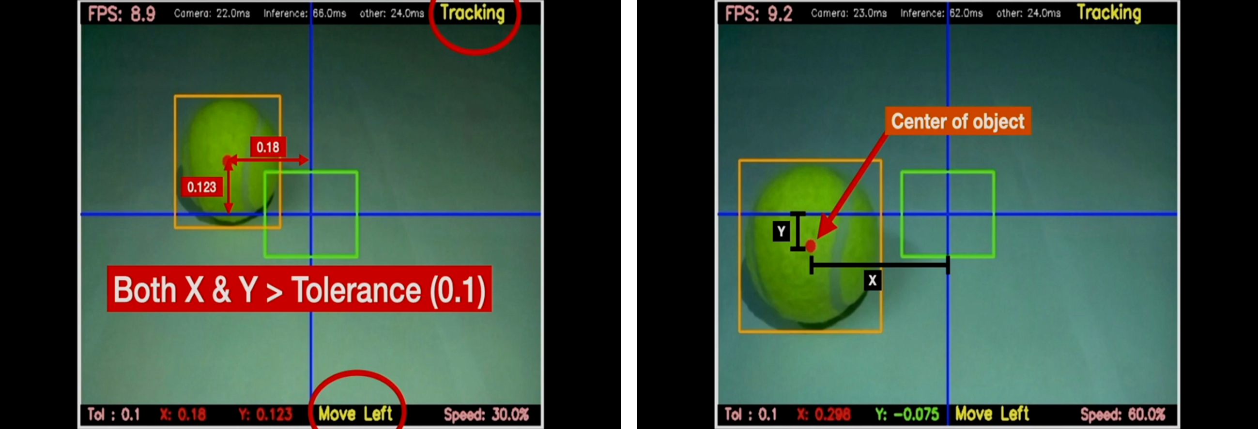
Project Evidence

Slide 24
References
Patrick Benavidez and Mo Jamshidi, “Mobile robot navigation and target tracking system,” 2011. Accessed: Aug. 01, 2023. [Online]. Available: https://ieeexplore.ieee.org/document/5966614
G. Kahn, P. Abbeel, and S. Levine, “BADGR: An Autonomous Self-Supervised Learning-Based Navigation System,” IEEE Robot Autom Lett, vol. 6, no. 2, pp. 1312–1319, Apr. 2021, doi: 10.1109/LRA.2021.3057023.
S.Arthika, S.Chidammabara Eswari, R.Prathipa and D.Devasena. “Bore well Child Fall Safeguarding Robot” (ICCSP 2018) published in the year 2018(IEEE).
Chunyan Ji, Thosini Bamunu Mudiyanselage, Yutong Gao and Yi Pan. “A review of infant cry analysis and classification” published in the year 2021(Springer).
Pruthvi Raj Myakala, Rajasree Nalumacha, Shivam Sharma and V.K.Mittal. “An Intelligent System for Infant Cry Detection and Information in Real Time”(ACIIW 2017) published in the year 2017(IEEE).
M.Benisha, Thandaiah Prabu R, Gowri.M, Vishali.K, Divya Priyadharshini.R, M.Anisha, Ponmozhi Chezhiyam and C.Jim Elliot. “Design of wearable device for child safety” (ICICV 2021) published in the year 2021(IEEE).

Slide 25

IT20280956 | Weerarathne R.M.S.S.
BSc (Hons) in Information Technology
Specializing in Computer Systems & Network Engineering

Slide 26
Component - 2
-Toddler Monitoring & Animal Detection System -

Slide 27
Introduction
How to accurately monitor the toddlers
in the absence of their parents?
How to detect un-authorized access to the child?
How to expel threatened animals using humane method?

Slide 28

Research Problem
The unavailability of an efficient and accurate system that provides virtual surveillance of toddlers' surroundings to detect possible threats to the kid. Also, expulsion of animals that can be threatened to the toddler using humane and non-invasive approaches.

Slide 29

Objectives
Specific Objective :
To design and develop a system for the robot that can offer virtual monitoring of a toddler's surroundings while safeguard him.
Sub Objectives :
To real-time detect any unpermitted presence.
To identify potential threats to the child's safety.
To expel animals that can be threatened to toddler without harm for both animal and toddler.

Slide 30
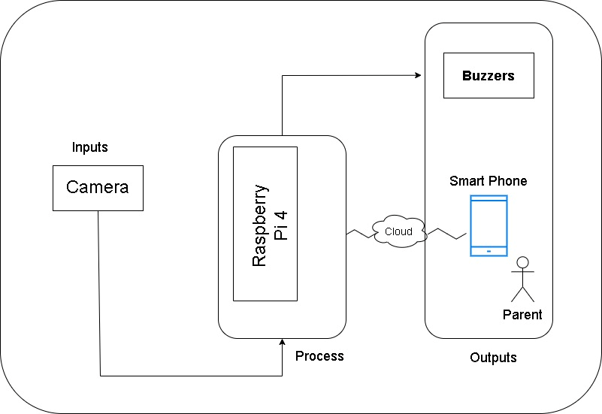
Methodology

Slide 31
Current Progress
Implementation of cameras to detect objects.
Camera is capable of capture the video of toddler and surroundings.
Trained a dataset through Open CV for detecting some domestic animals. (dog, and cat)
Animal expulsion system done successfully.

Slide 32

Results & Discussion
Results
Detect invasion of animals.
Generate a sound to expel the animal.
Discussion
Enhancement of accuracy in animal detection.
Low FPS Issue.

Slide 33
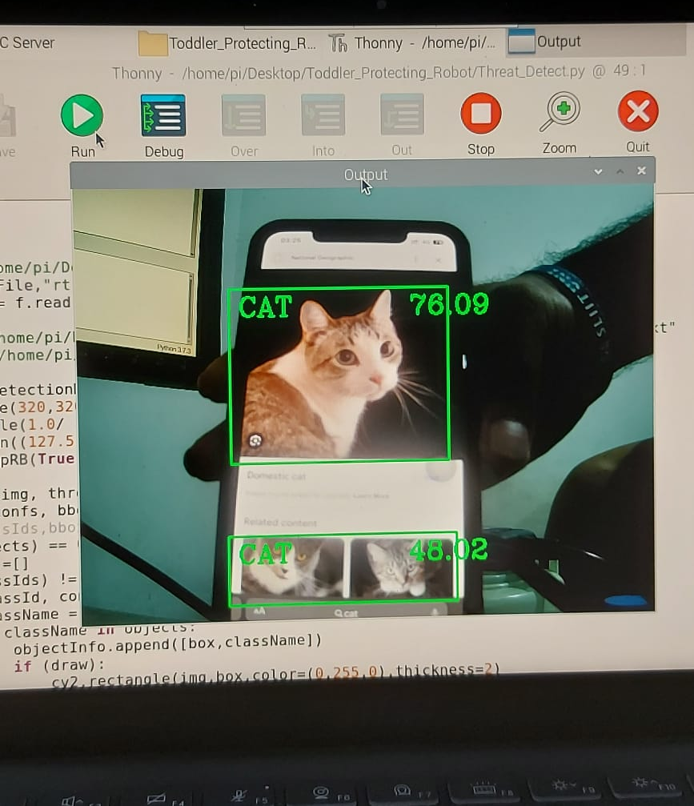
Project Evidence

Slide 34
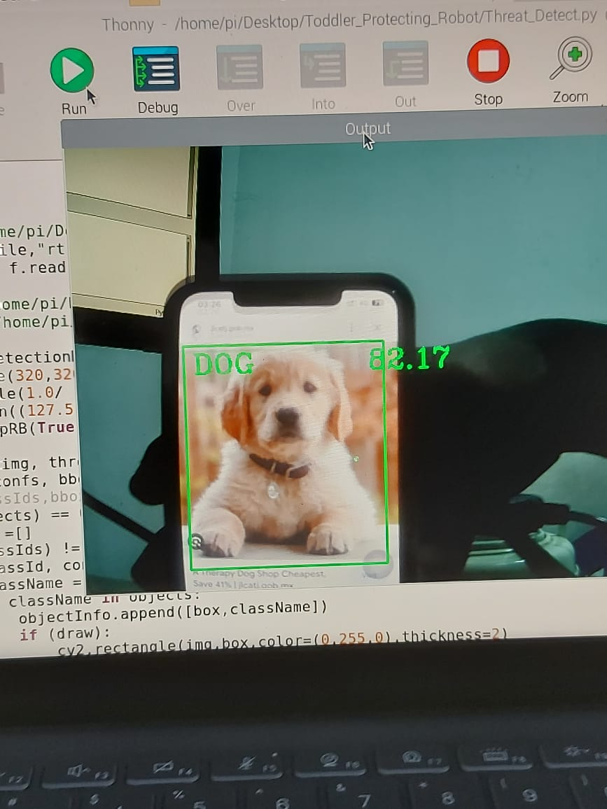
Project Evidence

Slide 35
References
P. Sreevardhan, B. Vidheya Raju, and Durgesh Nandan, " Animal Repellents from Agricultural Fields," Department of Electronics and Communication Engineering, 2020. [Online]. Available: https://link.springer.com/chapter/10.1007/978-981-15-4851-2_12
Waheb A. Jabbar, Saidatul N. I. S. Hamid, Akram A. Almohammedi, " 3) Internet of Things-Based Baby Monitoring System for Smart Cradle," July 2019. [Online]. Available: https://ieeexplore.ieee.org/abstract/document/8760478
[3] Harish S; Sudesh Rao; Chethan P, “Research on Survivalence of Rouge Wild Animals Using Image Processing and IOT,” Proceedings of 2019 1st International Conference on Advances in Information Technology (ICAIT), 25-27 July 2019, doi: 10.1109/ICAIT47043.2019.8987324.

Slide 36

IT20093150 | Lakshan W. R
BSc (Hons) in Information Technology
Specializing in Computer Systems & Network Engineering

Slide 37

Component - 3
- Toddler Crying Detection & Automate Lullabies Playing System -

Slide 38


Introduction
Developing a system that can automatically generate music or soothing lullabies in response to the cries of a toddler.
Parents are able to create a playlist by adding toddler's favourite songs or lullabies via music application. (Such as Spotify).

Slide 39

Research Problem
Currently there is no proper system for parents to look after their children while they are away from home.
This system is designed as a remedy for the discomfort caused by the baby when it sleeps and cries.

Slide 40
Specific Objective
To provide opportunities for busy parents to look after their children when they are away from home.
To avoid disturbances when the baby sleeps and cries.
Sub Objectives
To give the opportunity to have a free mind for child as well as parents.

Slide 41
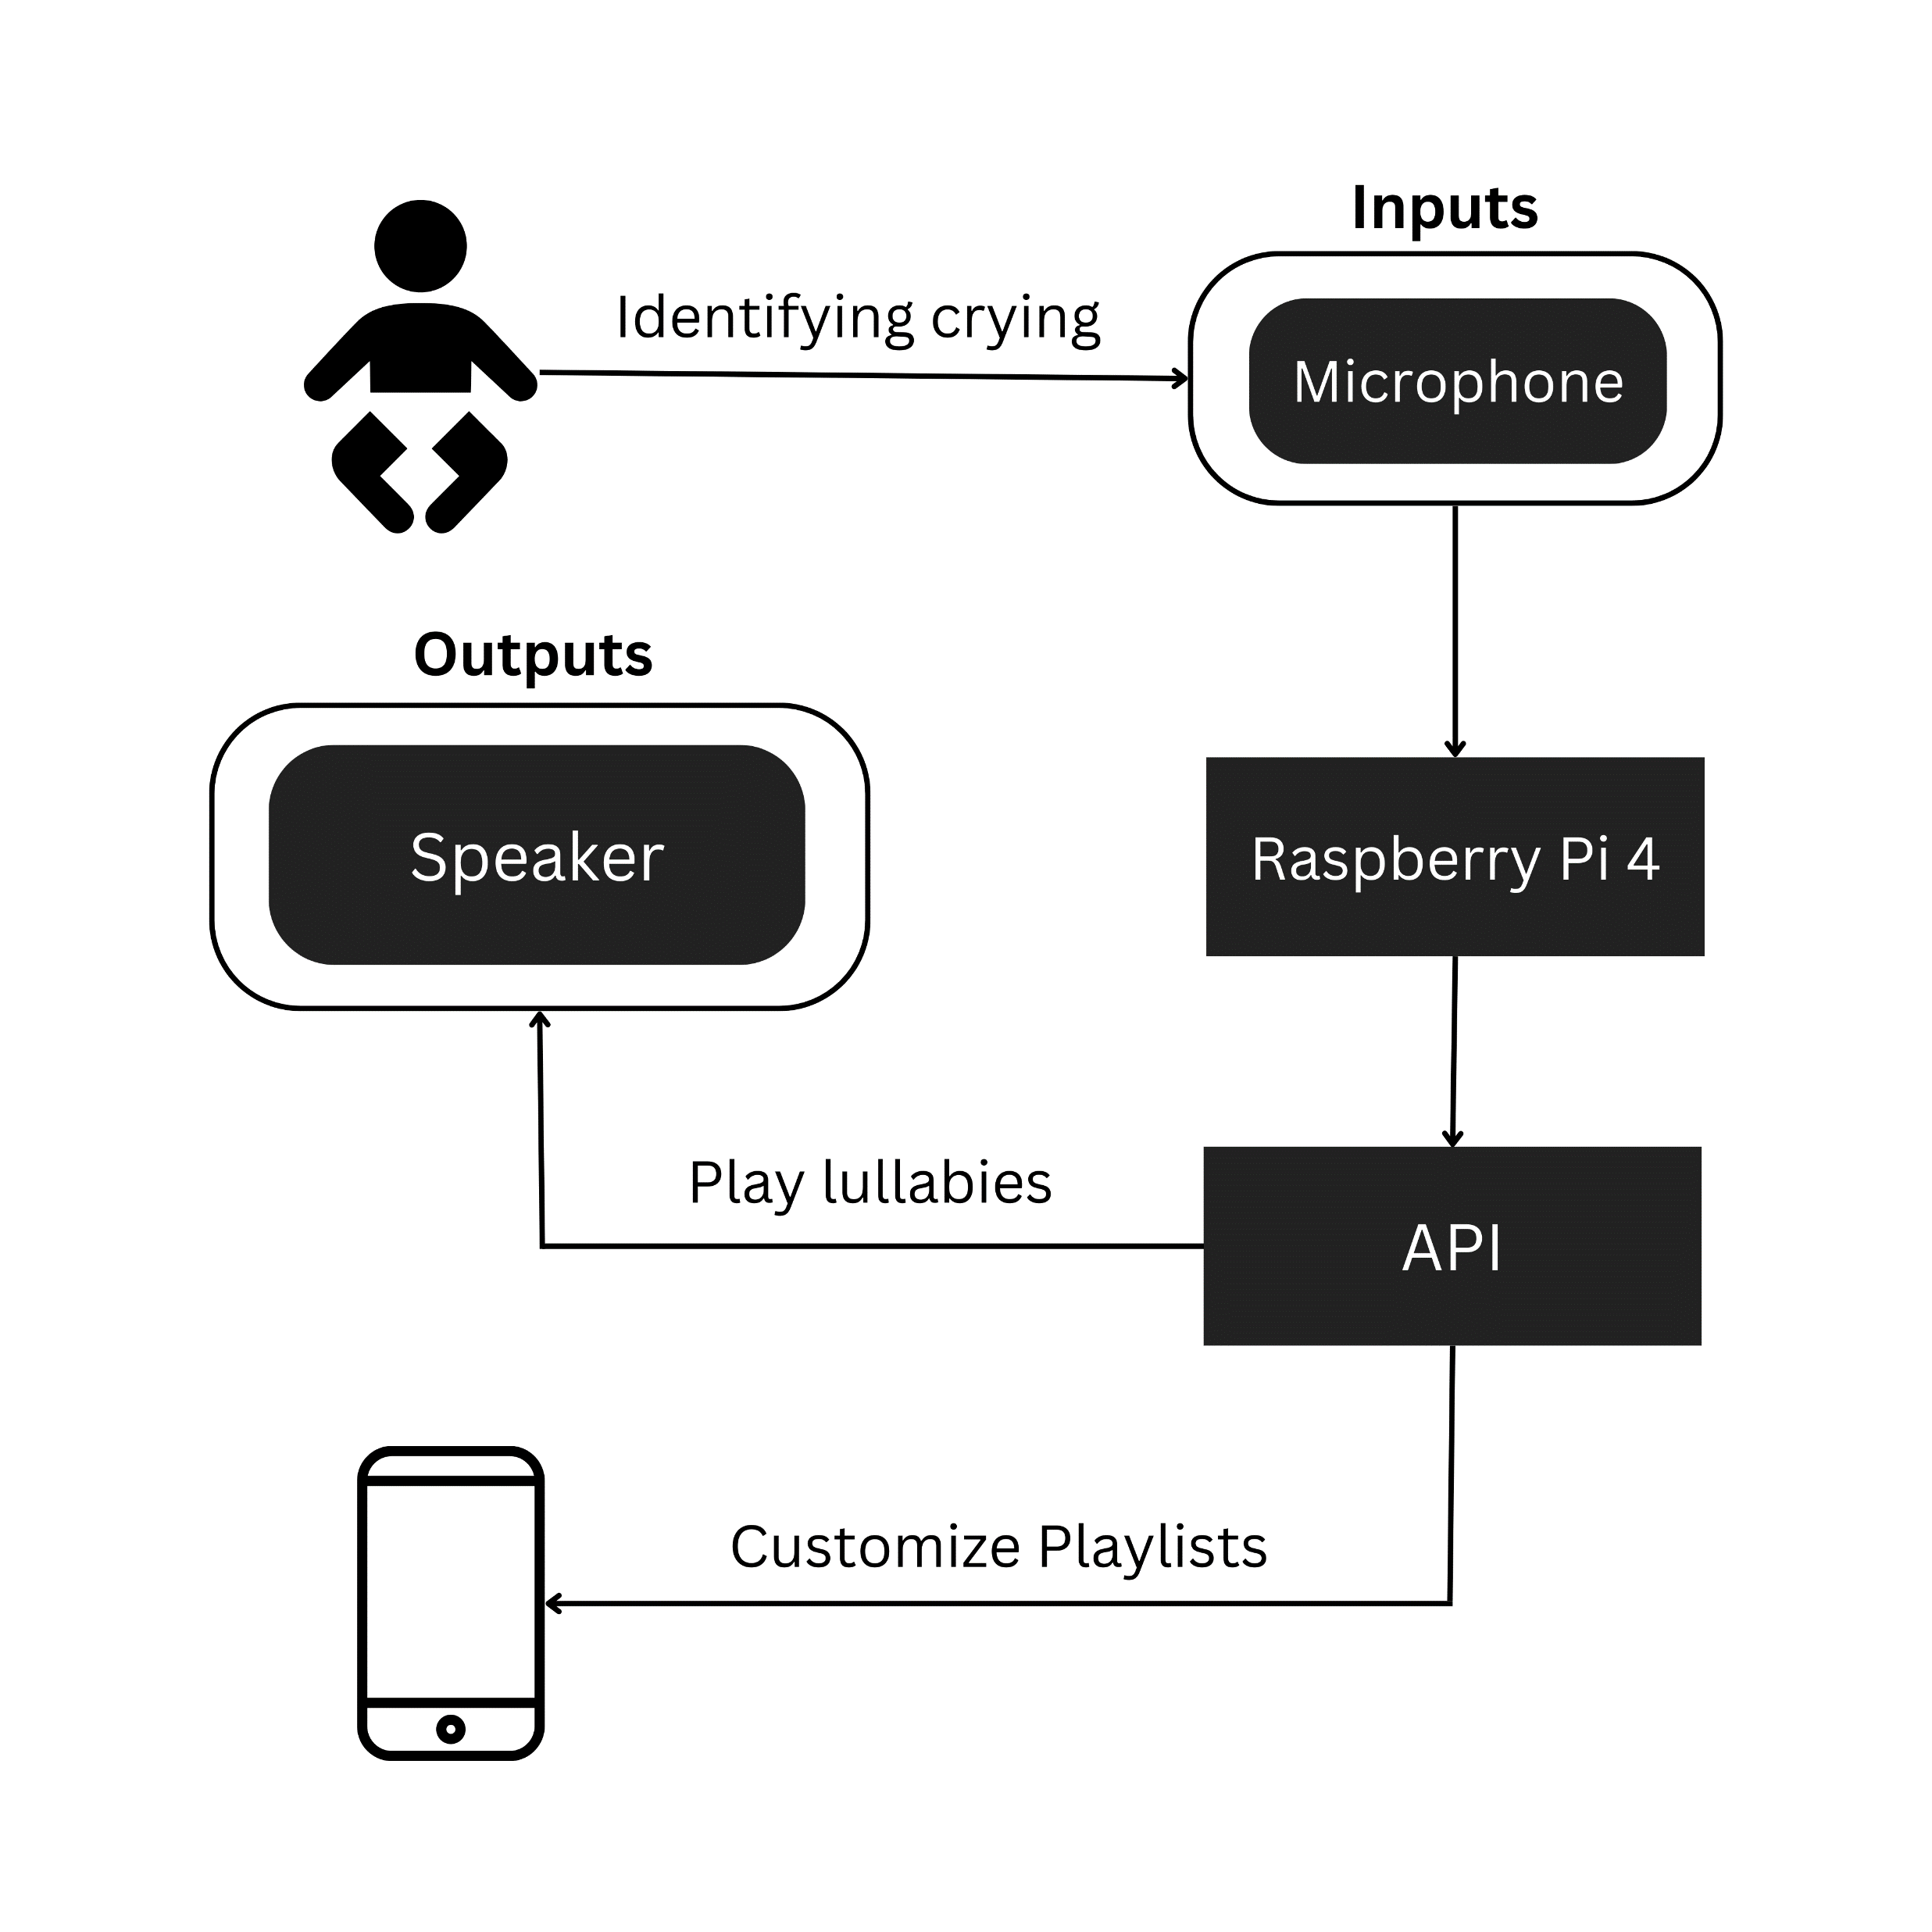
Methodology

Slide 42

Current Progress
Implementation of crying detection part to identify the toddler’s crying situations.
Implementation of speakers for playing lullabies.
Implementation of API to customise the playlists and play lullabies.

Slide 43
Objectives and project completion
80%
90%
100%
Crying Detection
Data set training and complete
Automatically play lullabies
Raspotify implementation
Exterior design work
Design the final casing for robot

Slide 44

Result and Discussion
Results
Mobility Performance
Automatic Response
Discussion
Customizable Lullabies
Quick Response Time

Slide 45
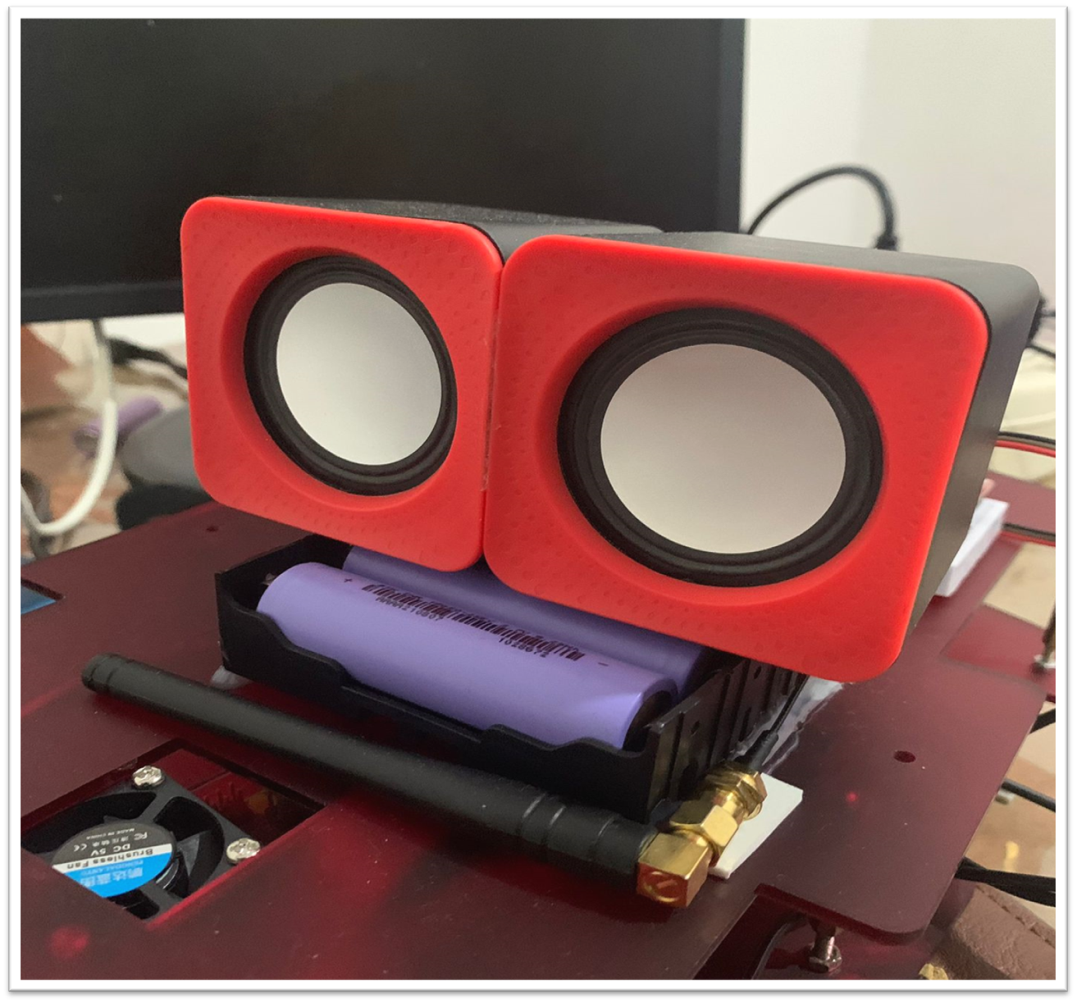
Evidence

Slide 46
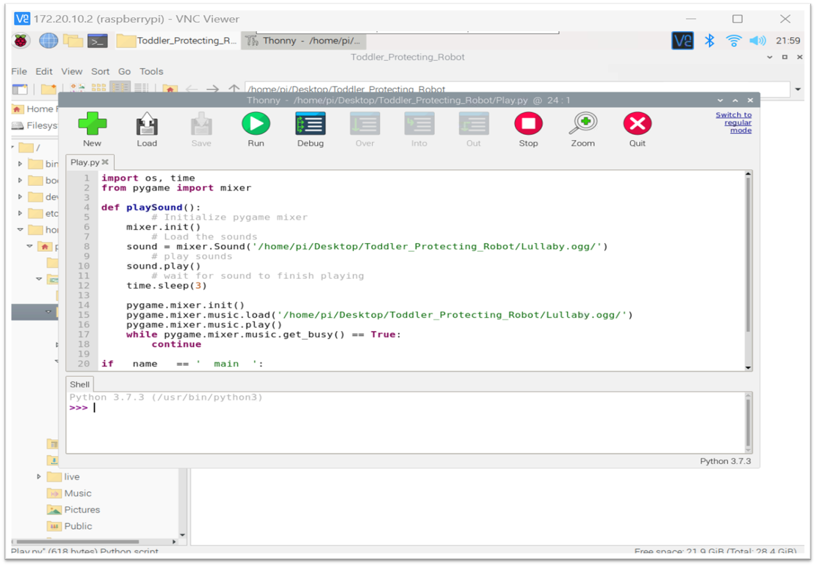
Evidence

Slide 47
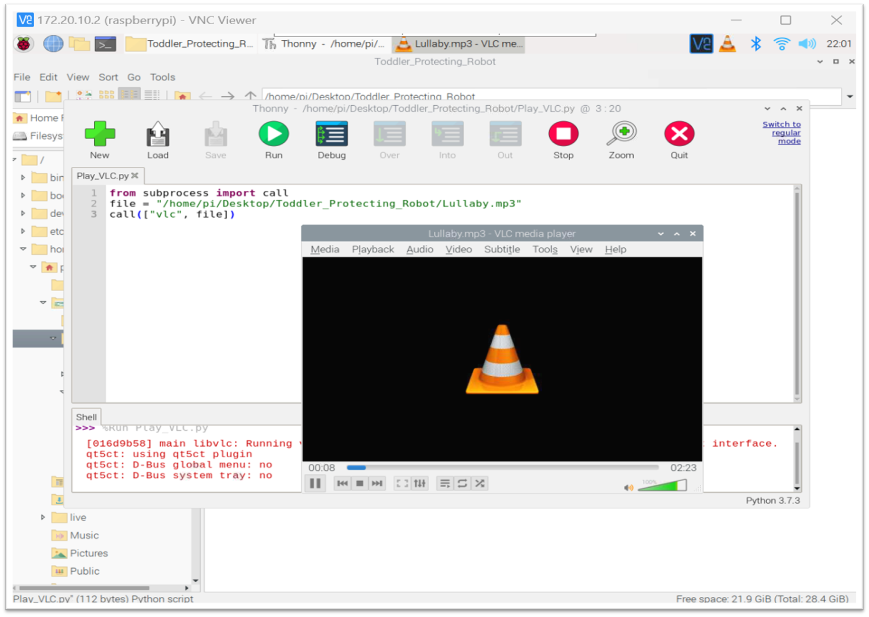
Evidence

Slide 48
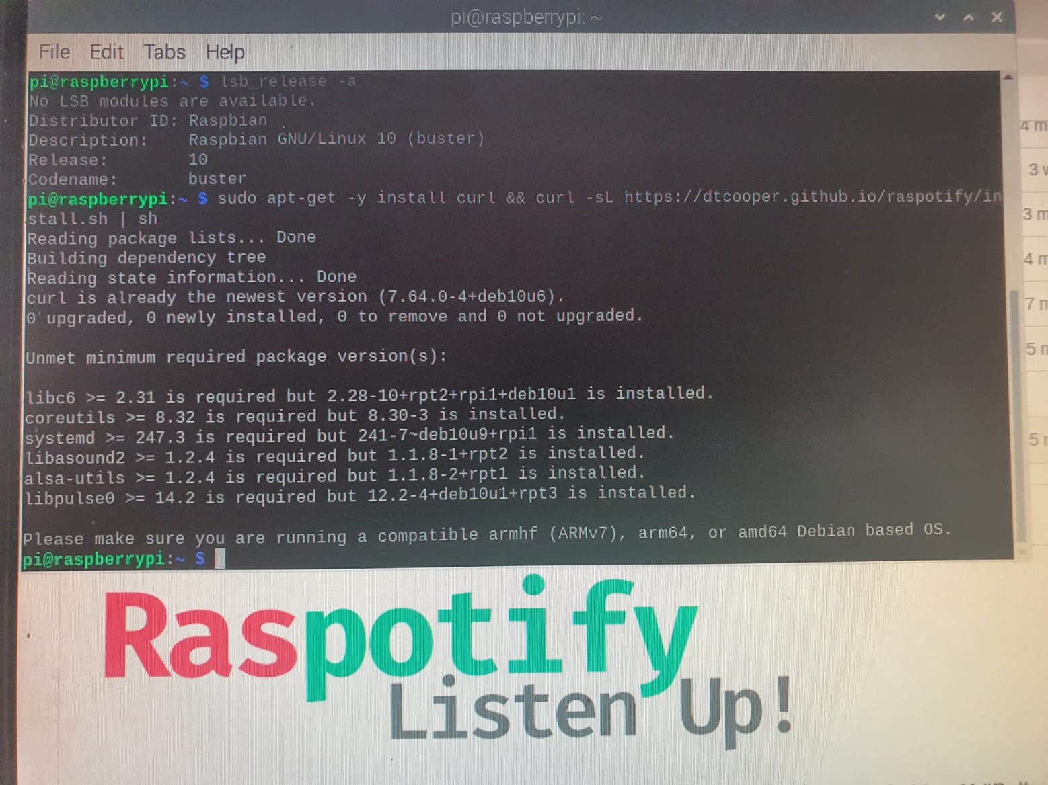
Evidence

Slide 49

Evidence

Slide 50
References
Swapnil Bhatnagar, Sharjeel Hasan, "Automatic Cradle System for Infant Care," ResearchGate, May 2021. [Online].Available:https://www.researchgate.net/publication/351686843_Automatic_Cradle_System_for_Infant_Care.
Rami Kohen, Yizhar Lavner, "Infant Cry Analysis and Detection," IEEE, 2012. [Online]. Available: https://ieeexplore.ieee.org/document/6376996.
Inoka Silva, Sampath Wickramasinghe, "Infant Cry Detection System with Automatic Soothing and Video Monitoring," ResearchGate, January 2017. [Online]. Available: https://www.researchgate.net/publication/342802422_Infant_Cry_Detection_System_with_Automatic_Soothing_and_Video_Monitoring_Functions.

Slide 51

IT20136260 | Maddepola M.A.D.K.B
BSc (Hons) in Information Technology
Specializing in Computer Systems & Network Engineering

Slide 52
Component -4
- Toddler behavior detection & alerting System -

Slide 53
Introduction
Parental concerns about understanding child's behavior and surroundings when they are away are prevalent.
Existing methods of communication often fail to provide accurate and timely information to parents regarding their child's behavior and environment.

Slide 54

Research Problem
How does parental absence impact the accuracy of understanding a child's behavior and their immediate surroundings, and what factors contribute to the challenges in obtaining a proper understanding?
Exploring the Challenges and Solutions in Communicating Accurate Information to Parents Regarding Their Child's Behavior and Environment

Slide 55
Specific Objective
Creating an alerting system that can accurately detect the behavior of the child and Informing parents rm the parents about ?
It detects the child's behavior when he runs, sleeps or climbs into a dangerous area, and alerts parents through an alarm system in case of animal invasion and crying.
Novelty
Capturing the child's behavior and providing an accurate alert to the parents.

Slide 56

Sub Objective
Integrating with all team members in order to assemble the robot and develop the user interface.
Developing an alert system that integrates all team members' functions

Slide 57
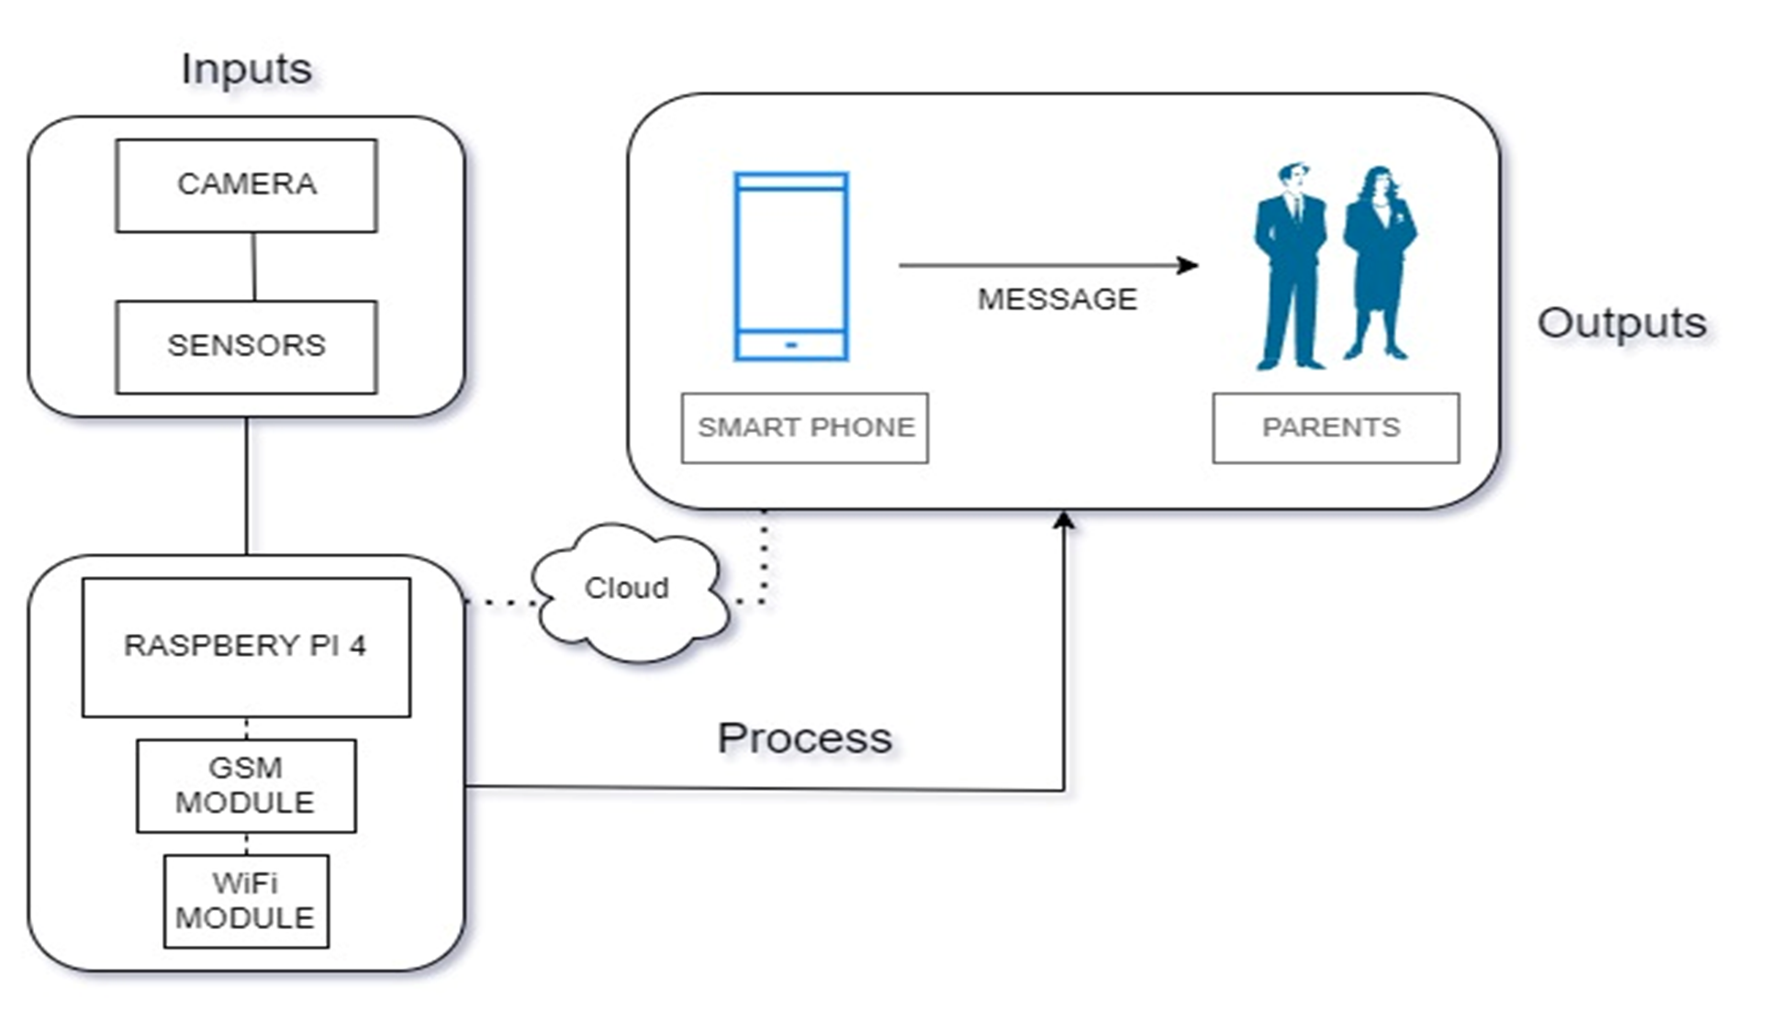
Methodology

Slide 58

Current Progress
Connecting and implementing SIM Module.
Implementing SIM module antenna.
Installing pi camera and web camera for behavior capturing part.
Installing of alerting system by providing external power.

Slide 59
OBJECTIVES AND PROJECT COMPLETION
Connecting and implementing SIM Module.
Implementing SIM module antenna.
Installing pi camera and web camera for behavior capturing part.
Installing of alerting system by providing external power.

Slide 60
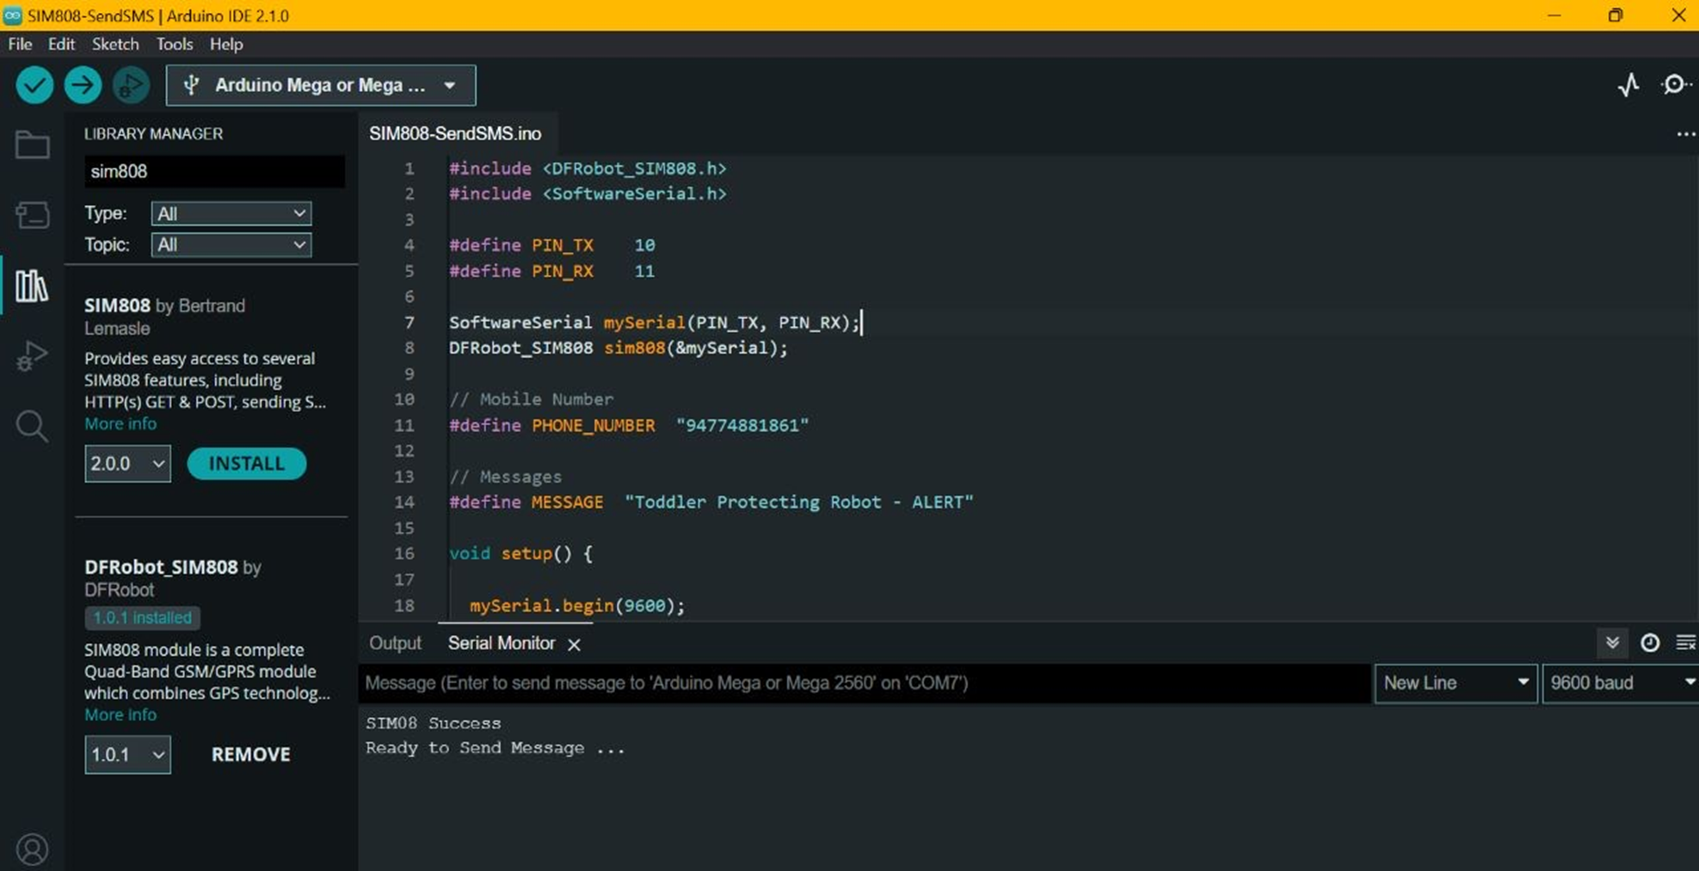
Evidence

Slide 61
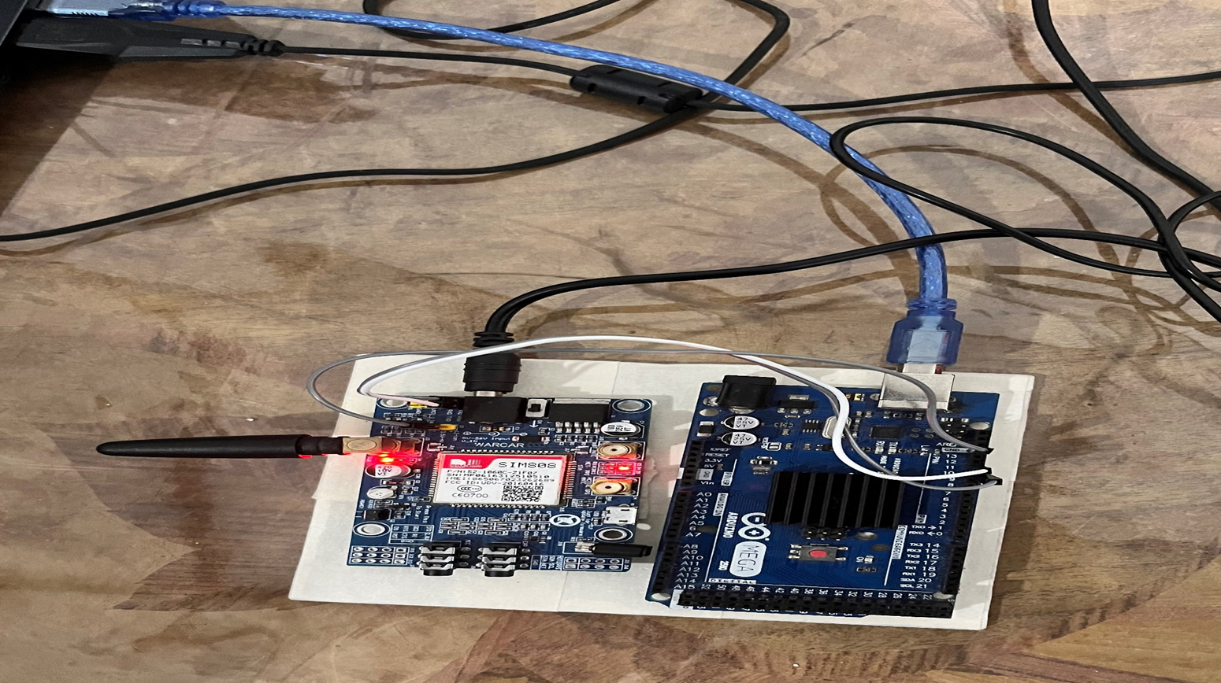
Evidence

Slide 62
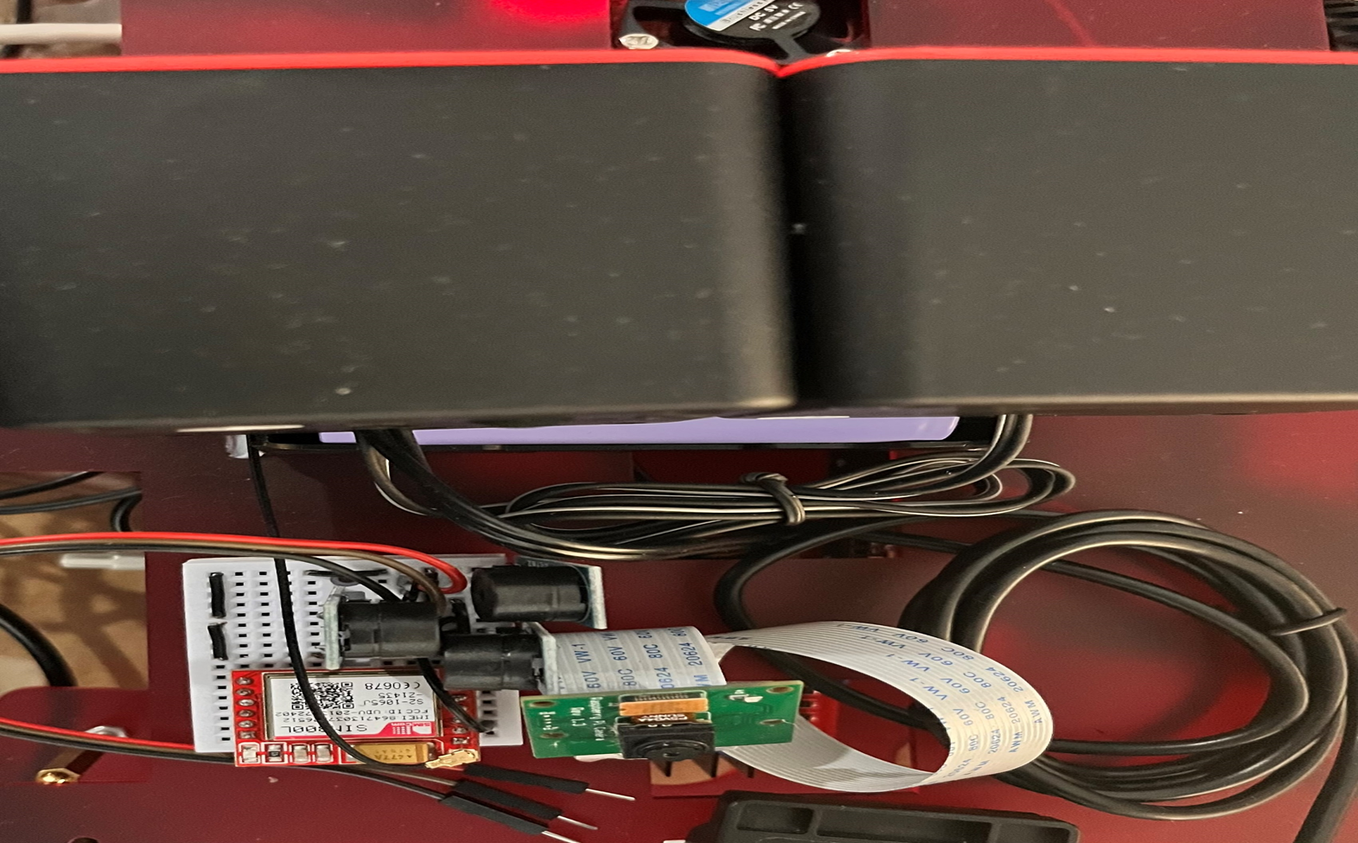
Evidence

Slide 63
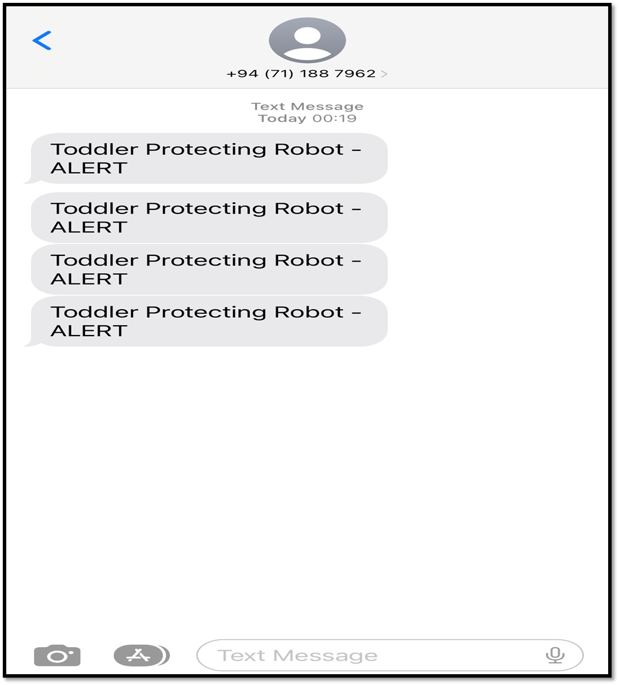
Evidence

Slide 64
References
Z. Zhang, "Robotics," Research on Childcare Robot and the Influence on, vol. 10, p. 9, 2022.
D. M. H. C.S. Shivraj, "International Research Journal of Engineering and Technology," ARTIFICIAL INTELLIGENCE FOR HUMAN BEHAVIOR ANALYSIS, vol. 05, no. 06, p. 8, June-2018.
Y. Liu, "A Robotic Prototype System for Child Monitoring," in International Journal of Robotics and Automation (IJRA), vol. 2, no. 1, 2011, pp. 65.

Slide 65
Thank You!

